Slide 1
Global Internet Usage
Insights
Results indicate clear differences in internet growth across continents, countries, and income groups.
Asia contributes the largest share of new internet users because of its large population, while Europe and North America add fewer users as their markets are closer to saturation.
Africa and South America show the fastest growth, indicating rapid expansion from later adoption.
Lower- and lower-middle-income countries grow faster than high-income countries, where growth has slowed as these countries are close to saturation.
Future internet growth will be driven mainly by developing regions, even though developed regions already have high usage levels.

Slide 2
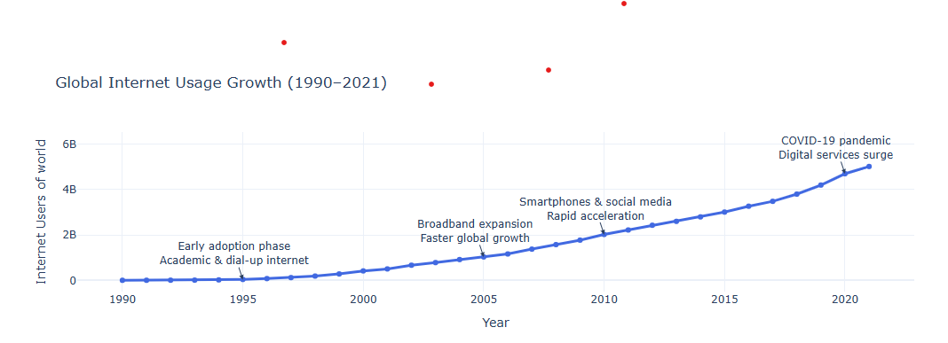
How has global internet usage evolved over time?

Slide 3
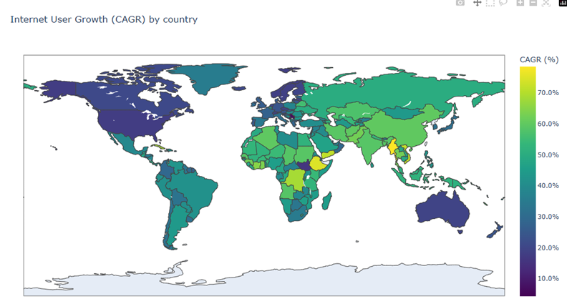
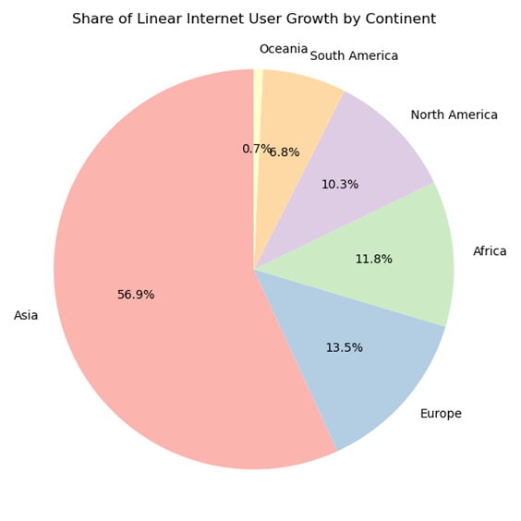
Global internet usage by continent and country

Slide 4
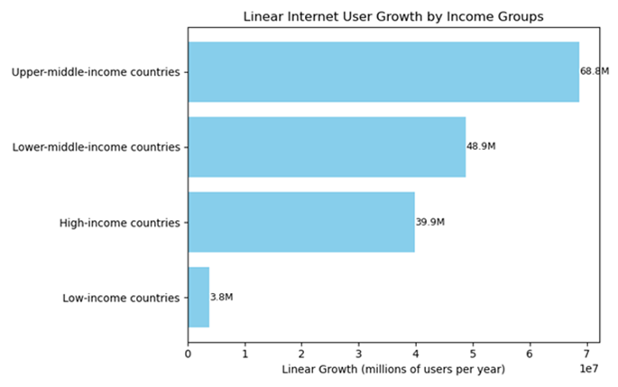
Global internet usage by income groups

Slide 5
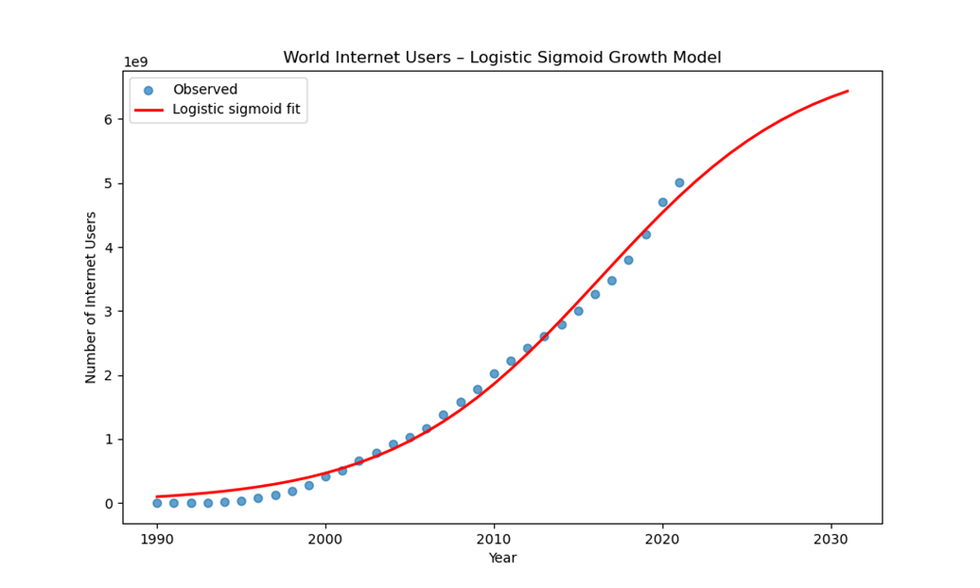
Expected pattern of world internet growth from 2021 to 2031
Conclusion
~The logistic sigmoid model shows an RMSE of approximately 131 million users and a relative error of about 8.3%, indicating a reasonably good fit with the historical data. When compared to real-world estimates for 2025, which report around 5.5–6 billion global internet users.
~Model’s forecast aligns closely with actual figures. This demonstrates that the logistic model not only captures the correct S-shaped pattern of adoption but also provides stable and reasonably accurate long-term predictions, making it suitable for understanding global internet growth trends.

